Slide 1
Factors Driving the Houston House Price Index
DGJ Group
De Vo, Gage Grewal, John Fallon

Slide 2
House Price Index (HPI)
Index for measuring changes in single-family home prices.
HPI is not adjusted for inflation.
HPI data normalized to 100 for year 1995.

Slide 3
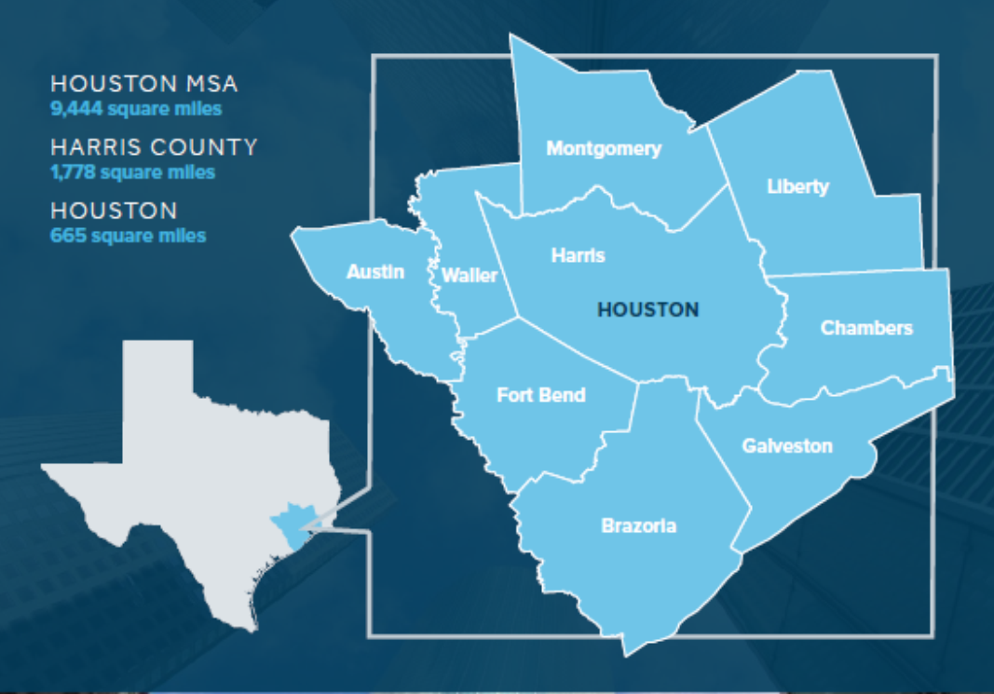
Houston MSA
(MSA – Metropolitan Statistical Area)

Slide 4
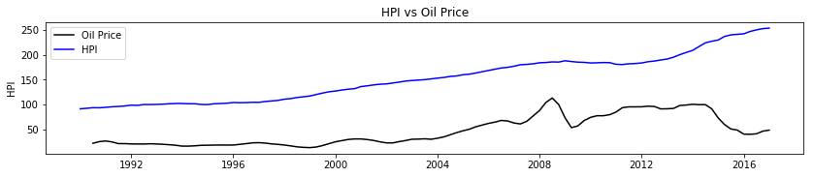
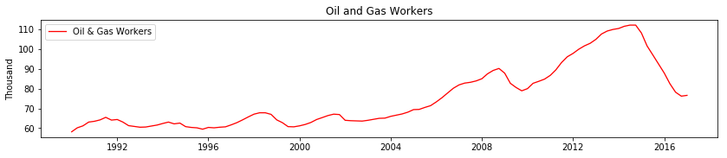
Houston HPI vs Oil Price

Slide 5
Regression Analysis – HPI vs Oil Price

Slide 6
Other Factors
Population
Mortgage & Interest Rates
Consumer Price Index (CPI)
Employment by Industry

Slide 7
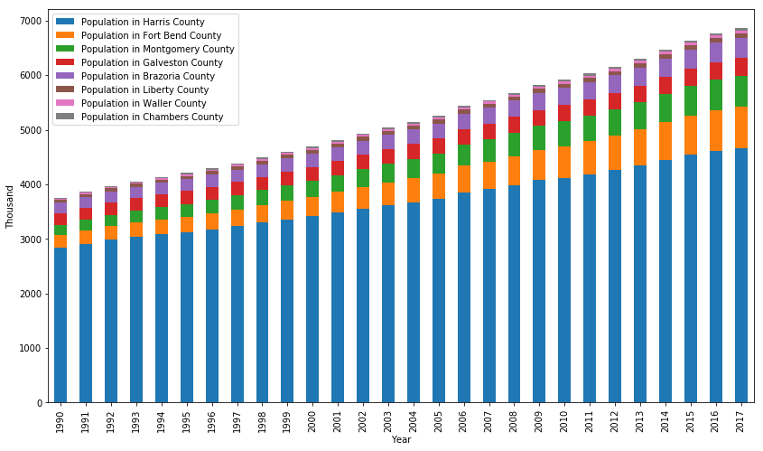
Population

Slide 8
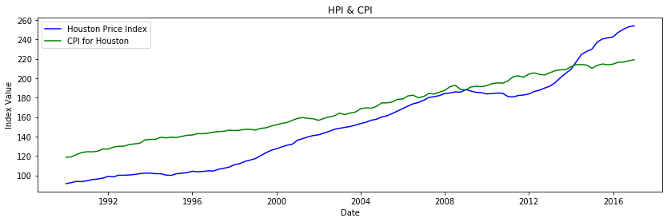
HPI vs CPI

Slide 9
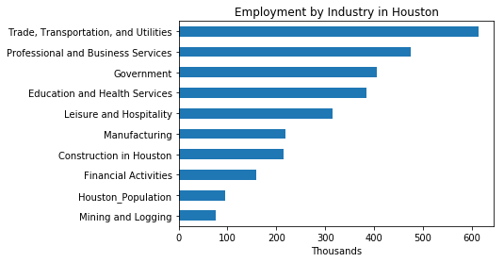
Employment by Industry

Slide 12
Conclusions

Slide 13
Limitations
Cost of Construction Materials

